Slide 1
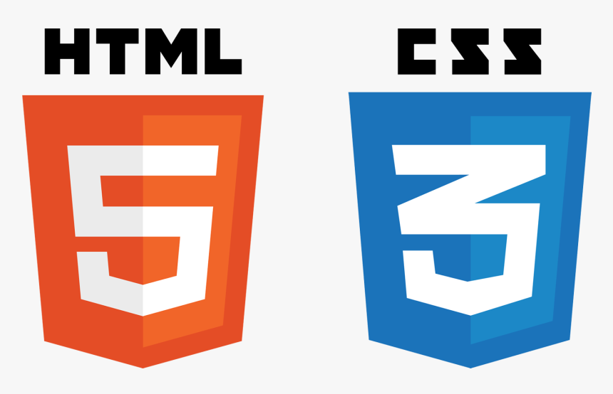

SE321
Lecture 3: Cascading Style Sheets (CSS)
SK. Fazlee Rabby
Lecturer
Department of Software Engineering
Daffodil International University

Slide 2
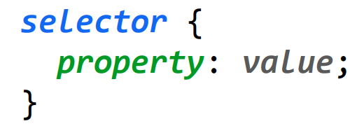
What is CSS?
CSS: Cascading Style Sheets
- Describes the appearance and layout of a web page
- Composed of CSS rules, which define sets of styles
A CSS file is composed of style rules:
selector: Specifies the HTML element(s) to style.
property: The name of the CSS style.
value: The value for the CSS style.
Saved in a filename.css file

Slide 3
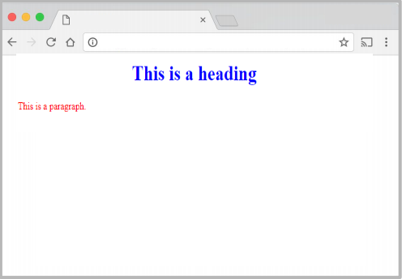
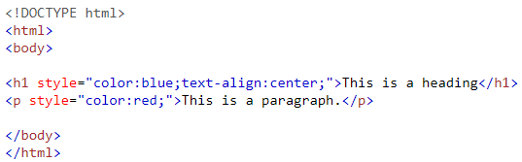
How To Add CSS to HTML
There are three ways to add CSS to our HTML file.
Inline CSS: An inline style may be used to apply a unique style for a single element. To use inline styles, add the style attribute to the relevant element. The style attribute can contain any CSS property.

Slide 4
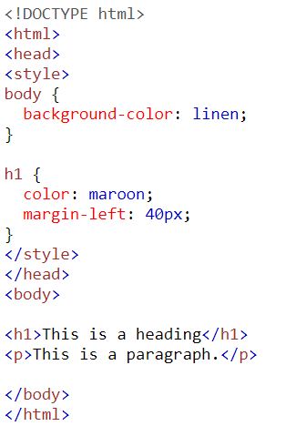
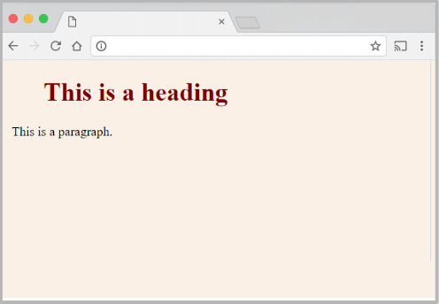
How To Add CSS to HTML
2. Internal CSS: An internal style sheet may be used if one single HTML page has a unique style. The internal style is defined inside the <style> element, inside the head section.

Slide 5
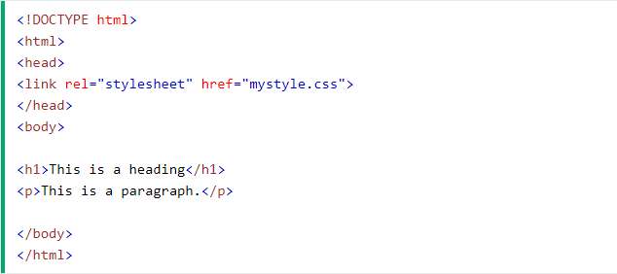
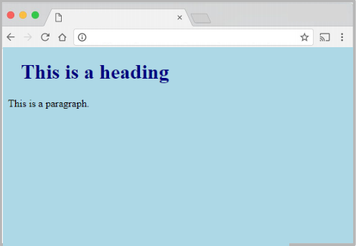
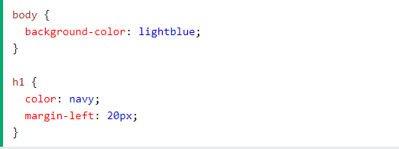
How To Add CSS to HTML
3. External CSS: With an external style sheet, you can change the look of an entire website by changing just one file! Each HTML page must include a reference to the external style sheet file inside the <link> element, inside the head section.
Index.html
mystyle.css

Slide 6
Common CSS Properties
TEXT PROPERTIES
Property | Description | Values
color | Sets the color of a text | RGB, hex, keyword
text-align | Aligns the text in an element | left, right, center, justify
text-decoration | Adds decoration to text | none, underline, overline, line-through
text-indent | Indents the first line of text in an element | length, %
text-transform | Controls the letters in an element | none, capitalize, uppercase, lowercase
line-height | Sets the distance between lines | normal, number, length, %
letter-spacing | Increase or decrease the space between characters | normal, length

Slide 7
Common CSS Properties
LIST PROPERTIES
Property | Description | Values
list-style | Sets all the properties for a list in one declaration | list-style-type, list-style-position, list-style-image, inherit
list-style-image | Specifies an image as the list-item marker | URL, none, inherit
list-style-position | Specifies where to place the list-item marker | inside, outside, inherit
list-style-type | Specifies the type of list-item marker | none, disc, circle, square, decimal, decimal-leading-zero, armenian, georgian, lower-alpha, upper-alpha, lower-greek, lower-latin, upper-latin, lower-roman, upper-roman, inherit

Slide 8
Common CSS Properties
BORDER PROPERTIES
Property | Description | Values
border | Sets all the border properties in one declaration | border-width, border-style, border-color
border-width | Sets the width of the four borders | thin, medium, thick, length, inherit
border-style | Sets the style of the four borders | none, hidden, dotted, dashed, solid, double, groove, ridge, inset, outset, inherit
border-color | Sets the color of the four borders | color_name, hex_number, rgb_number, transparent, inherit
border-top | Sets all the top border properties in one declaration | border-top-width, border-top-style, border-top-color
border-top-style | Sets the style of the top border | border-style
border-radius | specify the border-radius to make rounded corners | length

Slide 9
Common CSS Properties
FONT PROPERTIES
Property | Description | Values
font | Sets all the font properties in one declaration | font-style, font-variant, font-weight, font-size/line-height, font-family, caption, icon, menu, message-box, small-caption, status-bar, inherit
font-family | Specifies the font family for text | family-name, generic-family, inherit
font-size | Specifies the font size of text | xx-small, x-small, small, medium, large, x-large, xx-large, smaller, larger, length, %, inherit
font-style | Specifies the font style for text | normal, italic, oblique, inherit
font-weight | Specifies the weight of a font | normal, bold, bolder, lighter, 100, 200, 300, 400, 500, 600, 700, 800, 900, inherit Careful, many of these are not supported!

Slide 10
Have you heard of <div> and <span>?
What are they?
Two generic tags with no intended purpose or style:
<div>: a generic block element
<span>: a generic inline element

Slide 11
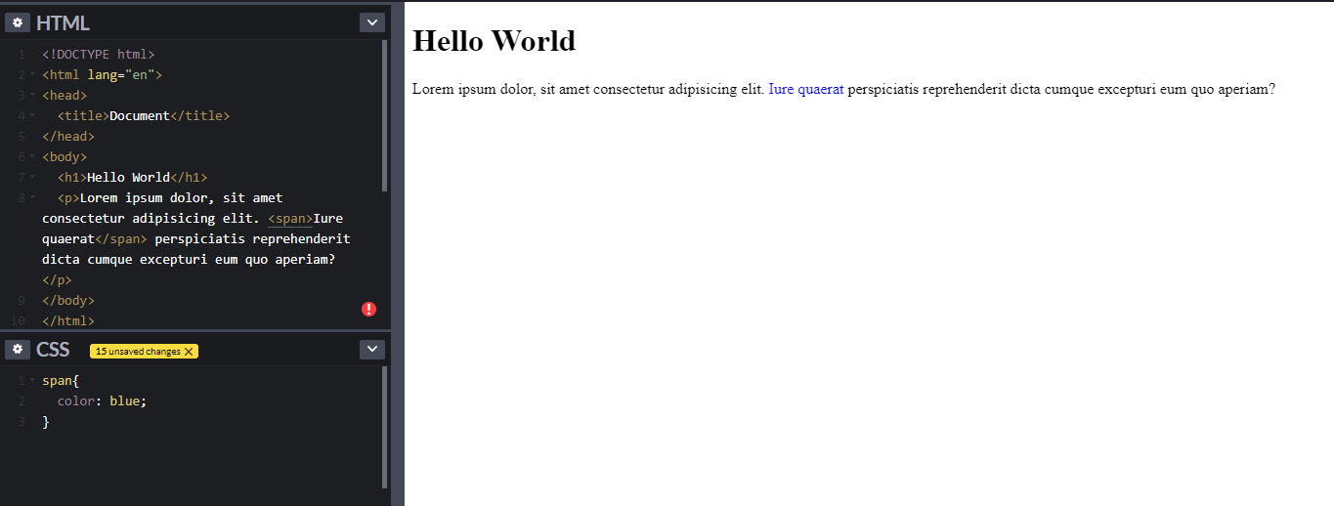
<span> in Action
We can use as a generic inline HTML container

Slide 12
Multiple Generic Containers
But won't we often want multiple generic containers?
How do we distinguish two generic containers?
In other words, how do we select a subset of elements instead of all elements on the page?
Classes and Ids

Slide 13
Class and Id
class and id are special HTML attributes that can be used on any HTML element
class: Used on 1 or more elements; identifies a collection of elements
id: Used on exactly 1 element per page; identifies one unique element
Can apply multiple classes by space-separating them: <span class="hw new">HW1</span>

Slide 14
Class and Id
There are 3 basic types of CSS selectors:
Element selector | p | All elements
ID selector | #abc | element with id="abc"
Class selector | .bcd | elements with class=“bcd"

Slide 15
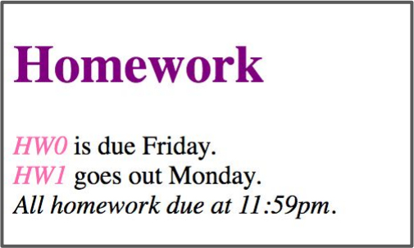
Class and Id
<h1 id="title">Homework</h1>
<em class="hw">HW0</em> is due Friday.<br/>
<em class="hw">HW1</em> goes out Monday.<br/>
<em>All homework due at 11:59pm.</em>
.hw {
color: hotpink;
}
#title {
color: purple;
}

Slide 16
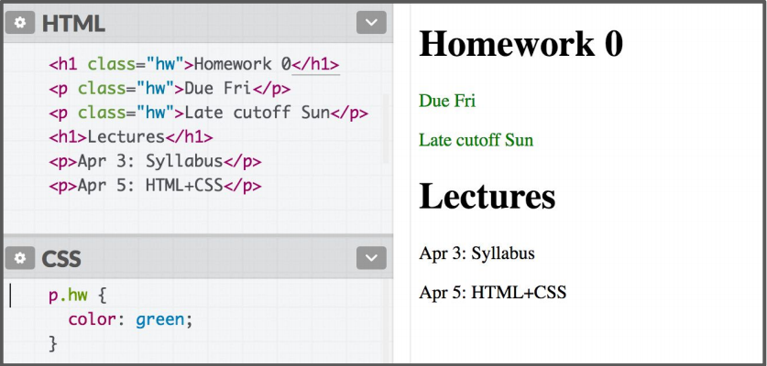
Other Selectors
element.className
Syntax | Example | Example Described
element.classname | p.abc | <p> elements with abc class

Slide 17
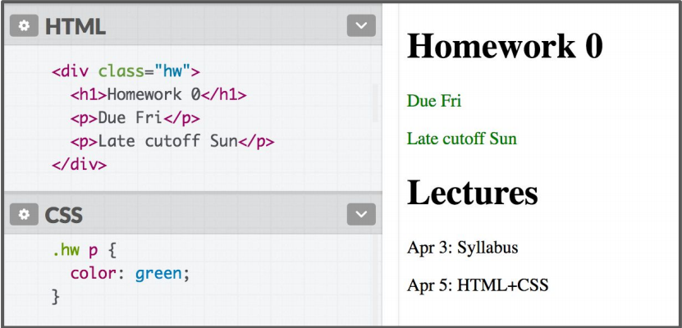
Other Selectors
Descendent Selector
Syntax | Example | Example Described
selector selector Note: The element does not have to be a direct child. The descendent may be nested many layers in. | div strong | <strong> elements that are descendants of a <div>
 | .abc p | <p> elements that are descendants of an element with class=“abc”

Slide 18
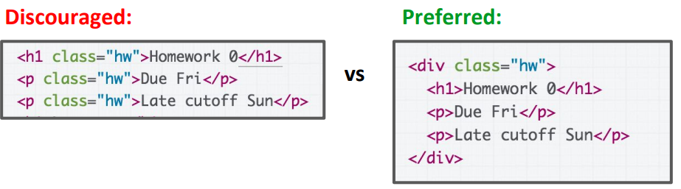
Other Selectors
Descendent Selector
Instead of applying a class to several adjacent elements, wrap the group in a <div> container and style the contents via descendent selectors.

Slide 19
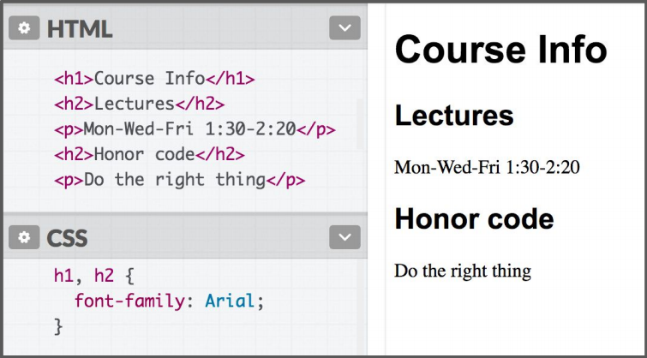
Other Selectors
Multiple Selectors
Syntax | Example | Example Described
selector, selector | h2, div | <h2> elements and <div>s
 | .abc, h1 | <h1> elements and all other elements with class=“abc”

Slide 20
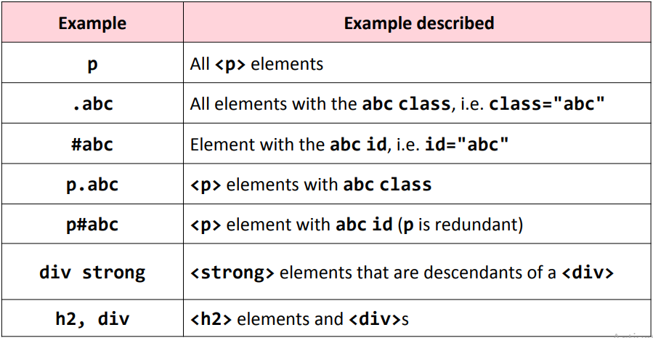
Selector Summary

Slide 21
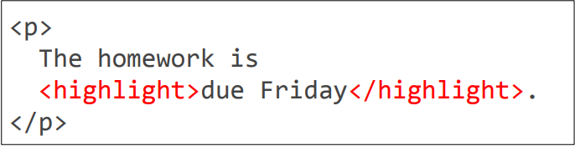
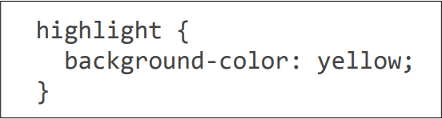
What HTML Elements Can I Use?
Question: Instead of <span class="highlight"></span>, can I create a <highlight> element?
Does this even work?

Slide 22
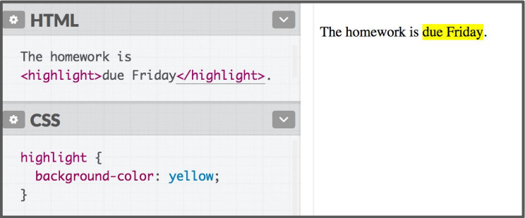
What HTML Elements Can I Use?
Answer: This will render perfectly fine.
But you shouldn't do this! It is non-standard behavior.

Slide 23
Wait !! But Why?
What is "standard" HTML?
Why does invalid HTML/CSS still work sometimes?
If my Java code is wrong, I get a compiler error… If my HTML or CSS is wrong, why don't I get an error?
Why does it matter that I follow "standard" HTML?

Slide 24

A Brief History of HTML
1989: World Wide Web created (WWW: web pages and the protocol in which they are served HTTP/HTTPS)
1994: World Wide Web Consortium created - "W3C": Goal to maintain and develop standards about how the web should work - Oversees several languages: - HTML, CSS, DOM, XML, etc
1997: "HTML4" published The first major stable version of HTML
Tim Berner’s Lee

Slide 25

Degrading Gracefully
The W3C HTML spec lists several design principles, and one is degrading gracefully.
"An escalator can never break: it can only become stairs"
This is why browsers do a best-effort to render non-standard
("invalid") HTML and CSS.

Slide 26
Why not enforce strict HTML?
It's also why <highlight> "works", even though it’s invalid HTML.
It's super weird that:
Browsers don't fail when given invalid HTML / CSS
Browsers not only don't fail, but they render invalid HTML/CSS seemingly "correctly"
Q: Why doesn't the browser reject poorly written HTML/CSS?

Slide 27
There was a (failed) attempt to enforce this, but it was too late: the Internet grew too big!
The nerdy, mostly* accurate
backstory for HTML today
*I would be more accurate, but it's hard to get valid sources online.

Slide 28



State of the world, 1997
Things Became Kind of Mess
Developers write weird, non-standard code
Standard say one thing
Browsers do another thing

Slide 29




2000ish (Not Totally Accurate)
Sure Whatever
Oops, that "degrading gracefully" thing was a mistake.
Browsers, stop rendering pages that have invalid HTML.
We can’t do that
What?!
That would break the internet
This was the proposal of XHTML 1.1

Slide 30

2004: WHATWG formed
The Web Hypertext Application Technology Working Group
Let's burn everything and start from scratch with XHTML 1.1 (break approx. 64 million websites)
Let's work on HTML5
(an imperfect but realistic standard)

Slide 31


Fast forward 2017?!
W3C gave up XHTML 1.1 in 2007
W3C and WHATWG are mostly friends (We Think), though they are still separate entities

Slide 32
What You Need to Know
Q: What HTML elements can I choose from? Check MDN's list of HTML tags
Q: How do I know if an HTML tag (or CSS property, or JS feature) is implemented on all browsers? Check caniuse.com
Q: Why shouldn't I use non-standard HTML/CSS/JavaScript, even if it works in every browser?
Because it won't be guaranteed to work in the future
Because it won't be guaranteed to work on all "user agents"

Slide 33
LET’S GET BACK TO CSS

Slide 34
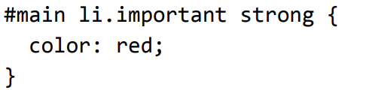
GUESS WHAT
p.abc
p .abc
p, .abc

Slide 35
GUESS WHAT
p.abc | A <p> element with the abc class
p .abc | An element with the abc class that descends from <p>
p, .abc | All <p> elements and all elements with the abc class
A: Read from right to left:
<strong> tags that are children of <li> tags that have an "important" class that are children of the element with the "main" id.

Slide 36
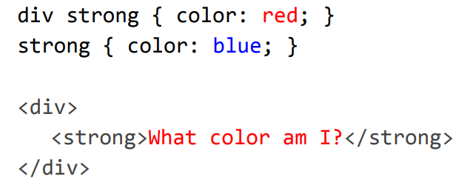
COLLIDING STYLES
When styles collide, the most specific rule wins (specificity)
Aside: The process of figuring out what rule applies to a given element is called the cascade. This is where the "C" in Cascading Style Sheets comes from.

Slide 37
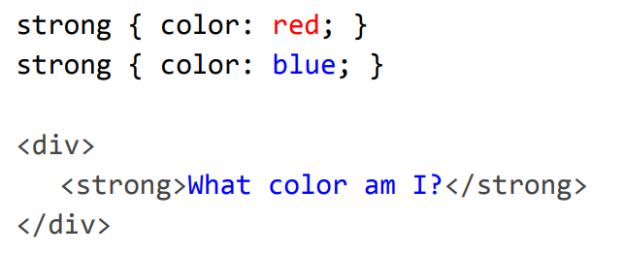
COLLIDING STYLES
Specificity precedence rules (details):
ids are more specific than classes
classes are more specific than element names
Style rules that directly target elements are more specific than style rules that are inherited
If elements have the same specificity, the later rule wins.

Slide 38
The !important exception
When an important rule is used on a style declaration, this declaration overrides any other declarations.
Although technically !important has nothing to do with specificity, it interacts directly with it.
Using !important, however, is bad practice and should be avoided because it makes debugging more difficult by breaking the natural cascading in your stylesheets.
Rules of Thumb:
Always look for a way to use specificity before even considering !important
Only use !important on page-specific CSS that overrides foreign CSS (from external libraries, like Bootstrap or normalize.css).
Never use !important when you're writing a plugin/mashup.
Never use !important on site-wide CSS.

Slide 39


Inheritance
While many CSS styles are inherited from parent to child, not all CSS properties are inherited.
There's no rule for what properties are inherited or not; the inheritance behavior defined in the CSS spec.
You can look it up via MDN, e.g.
font-family:
display:
Generally text-related properties are inherited and layout-related properties are not.
(You can also change this via the inherit CSS property, which is somewhat esoteric and not often use)

Slide 62
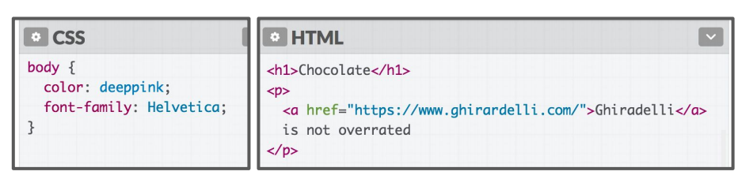
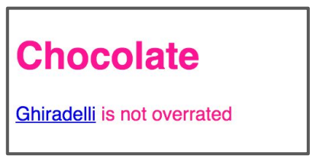
Anchor Tag
Hmm, MDN says color is inherited… but if I set the body color to deeppink, links don't change color
inherits font-family... Why doesn’t <a> inherit color?

Slide 63
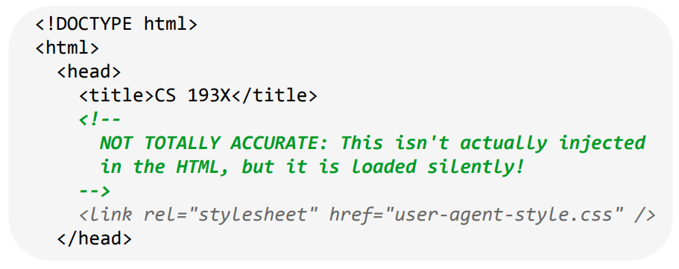
User Agent Styles
This is because the browser has its own default styles:
Browser loads its own default stylesheet on every webpage
Not governed by spec, but there are recommendations
SE321

Slide 64
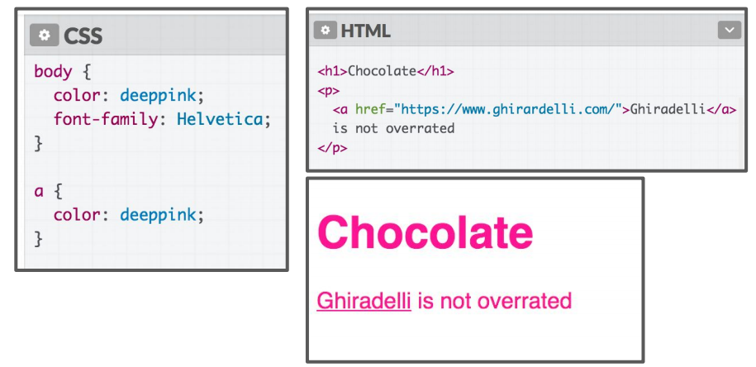
Anchor Tag

Slide 65
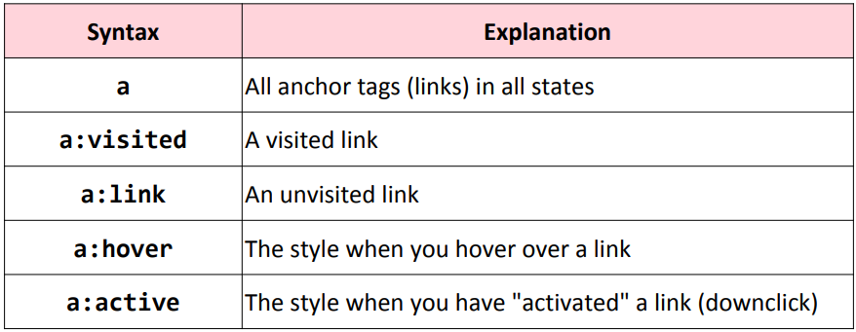
Link Related CSS
How do we style visited links differently from unvisited?
CSS pseudo-classes
pseudo-classes: special keywords you can append to selectors, specifying a state or property of the selector

Slide 66
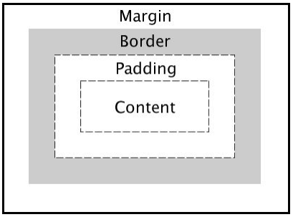
CSS BOX MODEL
Every element is composed of 4 layers:
The element's content
The border around the element's content
Padding space between the content and border (inside)
A margin clears the area around border (outside)

Slide 67
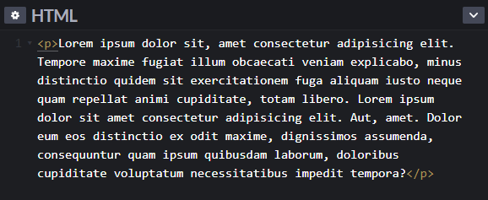
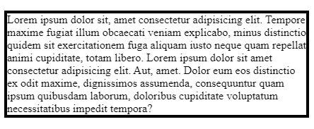
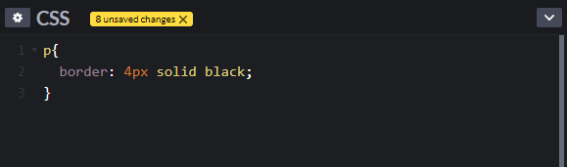
CSS BOX MODEL
When we add a border to an element, it sits flush against the text
Q: How do we add space between the border and the content of the element?

Slide 68
CSS BOX MODEL
A: We need to use Padding for our solution.
padding is the space between the border and the content.
Can specify padding-top, padding-bottom, padding-left, padding-right
There's also a shorthand:
padding: 2px 4px 3px 1px; [ top|right|bottom|left ]
padding: 10px 2px; [ top+bottom|left+right ]

Slide 69
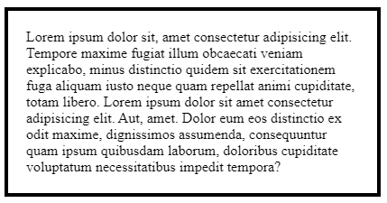
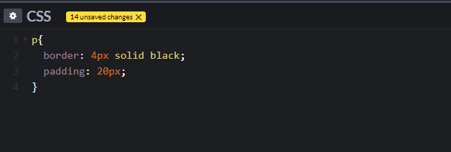
CSS BOX MODEL

Slide 70
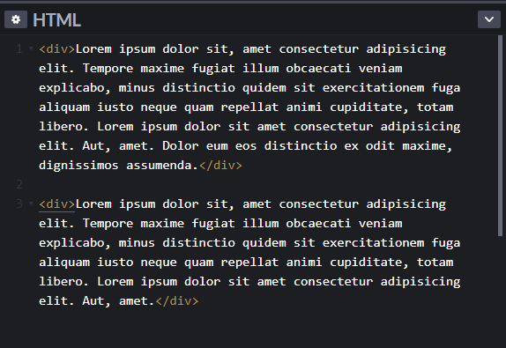
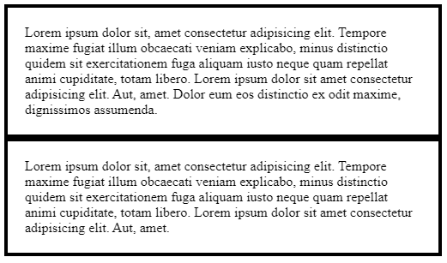
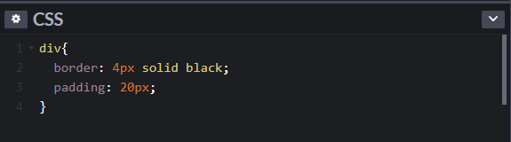
CSS BOX MODEL
When we add a border to multiple divs, they sit flush against each other
Q: How do we add space between multiple elements?

Slide 71
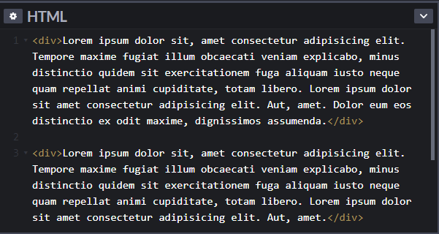
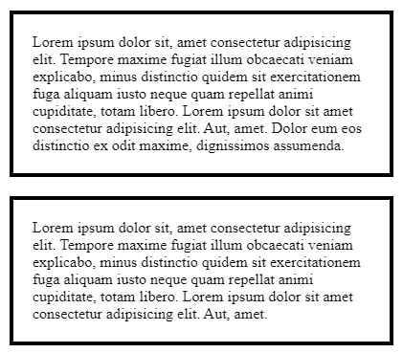
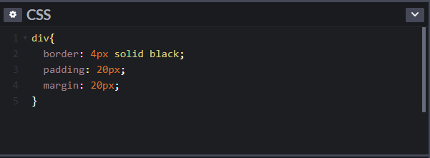
CSS BOX MODEL
A: We need to use Margin for our solution.

Slide 72

CSS LAYOUT
Q: Do we know enough to make something like that?
Begin visualizing the layout in terms of boxes

Slide 73
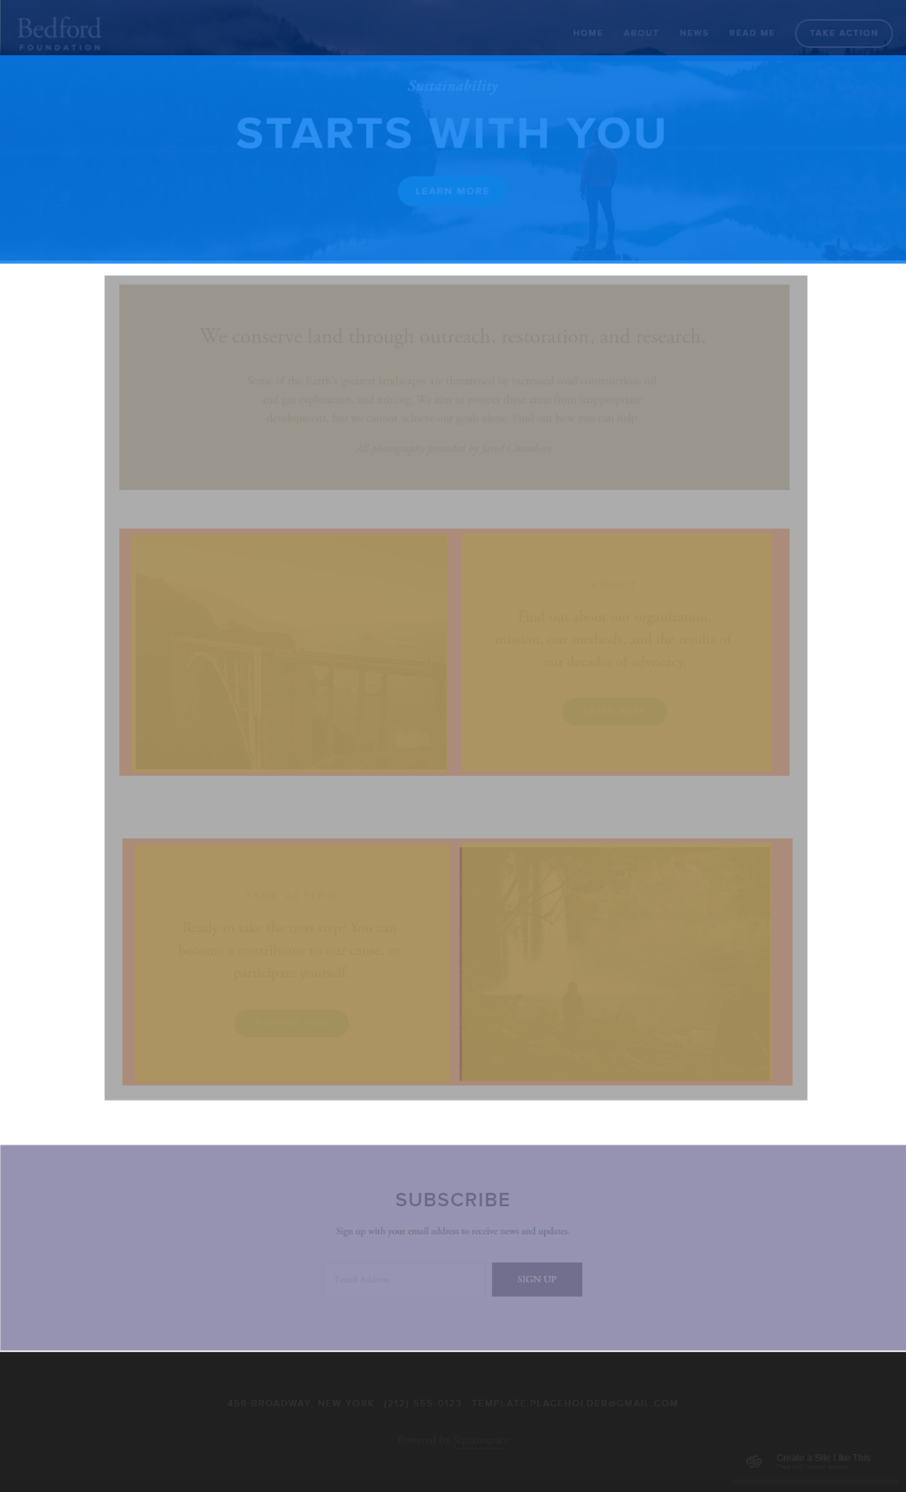
CSS LAYOUT
Q: Do we know enough to make something like that?
Begin visualizing the layout in terms of boxes

Slide 74
CONTENT SECTIONING ELEMENT
Name | Description
<p> | Paragraph (mdn)
<h1> - <h6> | Section headings (mdn)
<article> | A document, page, or site (mdn) This is usually a root container element after body.
<section> | Generic section of a document (mdn)
<header> | Introductory section of a document (mdn)
<footer> | Footer at end of a document or section (mdn)
<nav> | Navigational section (mdn)
These elements do not "do" anything; they are basically more descriptive <div>s. Makes your HTML more readable. See MDN for more info.

Slide 75
Header
Navbar:
Height: 75px
Background: royalblue
<nav>
Header:
Height: 400px;
Background: lightskyblue
<header>

Slide 76
Main section
Gray box:
Surrounding space: 75px above and below; 100px on each side
Height: 700px
Background: gray
<section>

Slide 77
Footer
Subscribe:
Height: 250px
Background: #bdc3c7
<section>
Footer:
Height: 150px
Background: #2c3e50
<footer>

Slide 78
Main Contents
Paragraph:
Height: 200px
Background: khaki
Space beneath: 75px
<p>
This is where we get stuck.
Orange Box:
Height: 400px;
Width: 48% of the parent's width, with space in between
Background: tomato
<div>

Slide 79
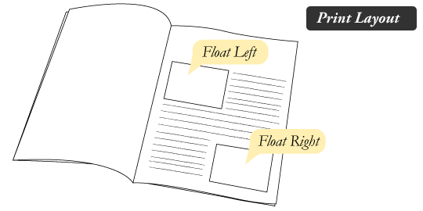
Float
Float is a CSS positioning property. To understand its purpose and origin, we can look to print design. In a print layout, images may be set into the page such that text wraps around them as needed. This is commonly and appropriately called “text wrap”. Here is an example of that.

Slide 80

Float
In web design, page elements with the CSS float property applied to them are just like the images in the print layout where the text flows around them. Floated elements remain a part of the flow of the web page.

Slide 81
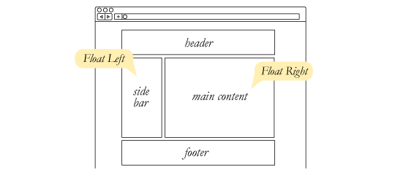
What Are Floats Used For?
Aside from the simple example of wrapping text around images, floats can be used to create entire web layouts.
While floats can still be used for layout, these days, we have much stronger tools for creating layout on web pages. Namely, Flexbox and Grid.

Slide 82

What Are Floats Used For?
Floats are also helpful for layout in smaller instances. Take for example this little area of a web page. If we use float for our little avatar image, when that image changes size the text in the box will reflow to accommodate.

Slide 83
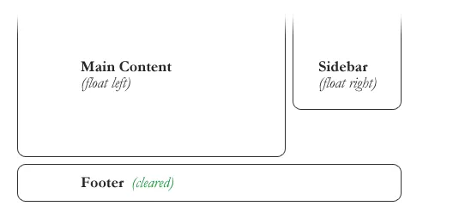
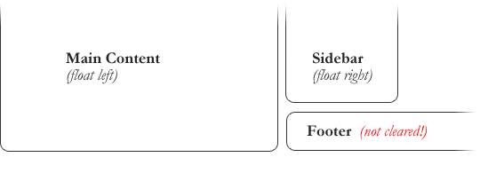
Clearing the Float
Float’s sister property is clear. An element that has the clear property set on it will not move up adjacent to the float like the float desires, but will move itself down past the float. Again an illustration probably does more good than words do.

Slide 84
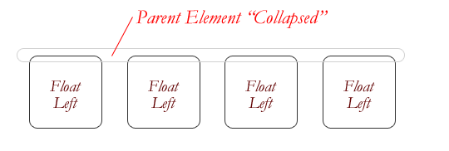
The Great Collapse
One of the more bewildering things about working with floats is how they can affect the element that contains them (their “parent” element).
If this parent element contained nothing but floated elements, the height of it would literally collapse to nothing.
One way we can solve this issue can be applying “overflow: auto” to the parent element so that the parent element includes all the floated elements.

Slide 85
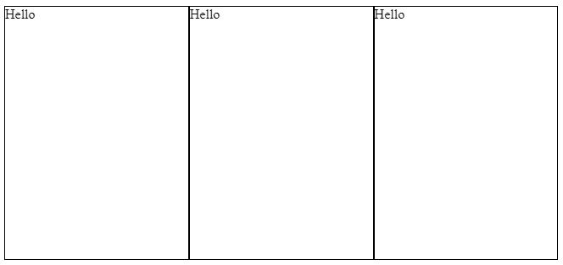
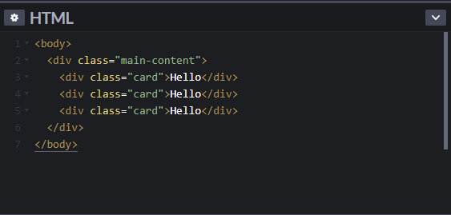
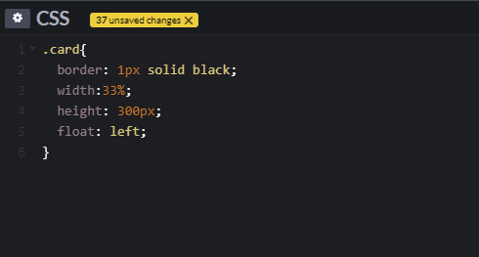
The box-sizing Property
The box-sizing property defines how the width and height of an element are calculated: should they include padding and borders, or not.
The default value is content-box. In the content box, The width and height properties (and min/max properties) includes only the content. Border and padding are not included

Slide 86
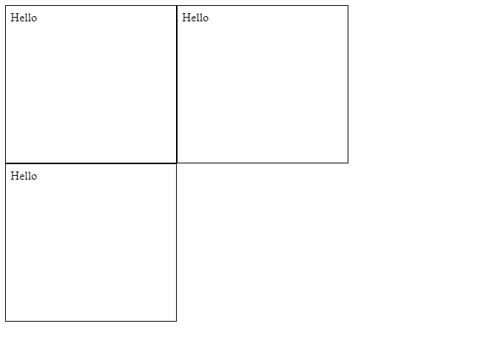
The box-sizing Property
To solve this problem, we can apply box-sizing: border-box property to our element. In border-box, The width and height properties (and min/max properties) includes content, padding and border.

Slide 87
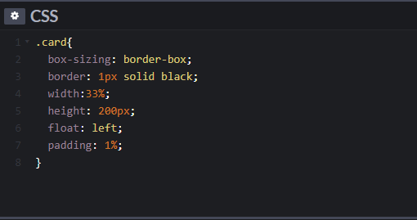

The box-sizing Property

